Slide 1
PartyGuard Web Application
End term presentation
Team 52 - PartyGuard Web Application-PartyFreaks
1

Slide 2
Outline
Team Members
Team Members Responsibilities
Client Information
PartyGuard Web Application Description
Modules and functionalities
Technology Stack
Demo
Challenges
Future Tasks
Lessons Learnt
Team 52 - PartyGuard Web Application
2

Slide 3
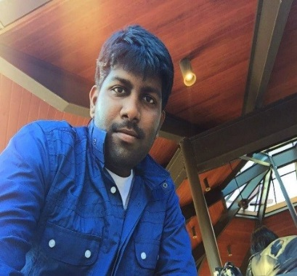
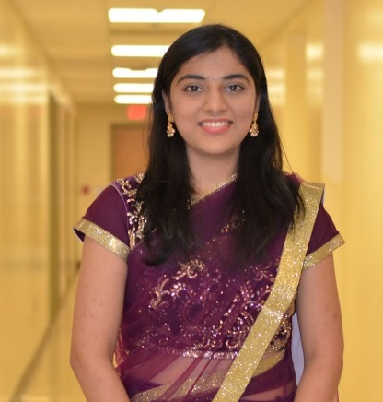
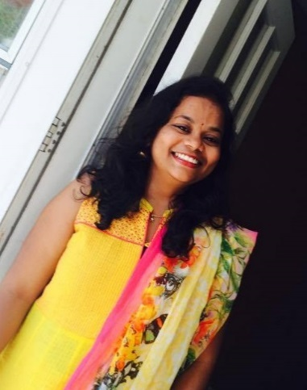
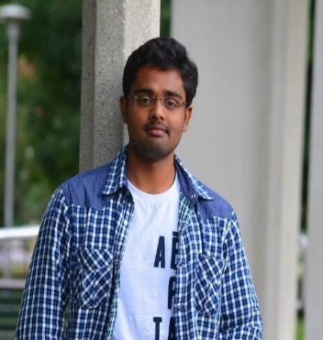
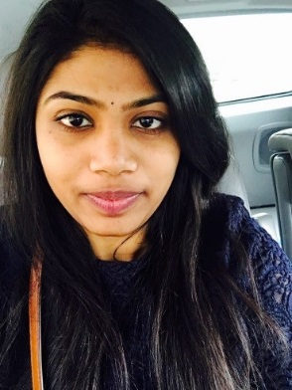
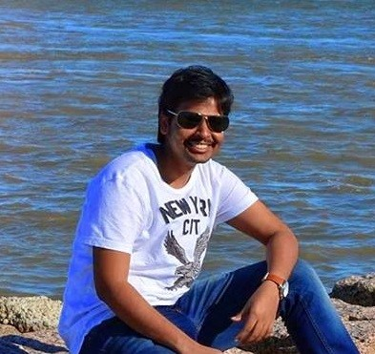
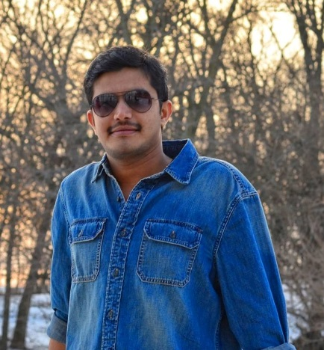
Team Members
Abishai
Nihitha
Sindhuja
Srichaitanya
Spandana
Lokesh
Gopinadh
3
Team 52 - PartyGuard Web Application

Slide 4
Team Member Responsibilities
Role | Team Member
Primary Contact | Prem Abishai Parise
Client Management | Nihitha Reddy Bhimireddy
Requirements Management | Lokesh Reddy Pothapu
Data Management | Srichaitanya Peddinti
Issues Management | Sindhuja Pannala
Quality and Testing Management | Spandana Velaga
Communications and Documentation Management | Gopinadh Cherupally
Team 52 - PartyGuard Web Application
4

Slide 5

Client Information
Client mission:
To develop a web application for users
which will help them to prevent sexual
assaults and accidents happening within
Greek life specifically fraternity houses.
Jacob C Stansbury
S516098@mail.nwmissouri.edu
Team 52 - PartyGuard Web Application
5

Slide 6
PartyGuard-Web Application
It is a web application which will be accessible to three kinds of users (i,e Master user, Host user, Guard user and Basic user)
This application will offer service to subscribed fraternity houses only
Then the subscribed fraternity can use PartyGuard in their social gatherings to create a safe environment
This PartyGuard web application works in coordination with Android application and iOS application
Team 52 - PartyGuard Web Application
6

Slide 7
Modules
Admin User
Admin
Dashboard.html
Dashboard.js
AddCustomer.html
AddCustomer.js
Module
View
Controller
ViewCustomers.html
Addack.html
Addack.js
ViewCustomers.js
Team 52 - PartyGuard Web Application
7

Slide 8
Modules(Contd..)
Host User
Host
HostProfile.html
HostProfile.js
Events.html
Events.js
Module
View
Controller
HouseLocation.html
EditEvents.html
EditEvents.js
HouseLocation.js
Members.html
Members.js
NewCustomer.html
NewCustomer.js
8
Team 52 - PartyGuard Web Application

Slide 9
Modules(Contd..)
Guard User
Guard
GuardProfile.html
GuardProfile.js
GuardRegistration.html
GuardRegistration.js
Module
View
Controller
Team 52 - PartyGuard Web Application
9

Slide 10
Modules(Contd..)
Basic User
Basic
BasicProfile.html
BasicProfile.js
Module
View
Controller
Team 52 - PartyGuard Web Application
10

Slide 11







Tools and Technologies Stack
Web Technologies
Team 52 - PartyGuard Web Application
11

Slide 12



Tools and Technologies Stack (Contd..)
Tools
Team 52 - PartyGuard Web Application
12

Slide 13


Tools and Technologies Stack (Contd..)
Version Control
Database
Team 52 - PartyGuard Web Application
13

Slide 14


Tools and Technologies Stack (Contd..)
Deployment
14
Team 52 - PartyGuard Web Application

Slide 15
What has been done?
Master User
Master user login
Adding customer/fraternity
View customers
Provided validations
Team 52 - PartyGuard Web Application
15

Slide 16
What has been done?(Contd..)
Host User
Host user login (Using credentials given by admin)
Create an event
Assign guards to the created event (call back function)
View members(guards)
Team 52 - PartyGuard Web Application
16

Slide 17
What has been done?(Contd..)
Guard User and Basic User
Guard user login
Edit guard user profile
Change password
Basic user login
Edit basic user profile
Team 52 - PartyGuard Web Application
17

Slide 18
What’s new?
Master User
Email functionality in Customer acknowledgement page
Admin dashboard updates dynamically
Team 52 - PartyGuard Web Application
18

Slide 19
What’s new? (Contd..)
Host User
Integrated all the APIs required for host user functionalities.
The host user can edit/delete the created events
The created events are updated dynamically in View events page
Guards can be assigned to the created events
Team 52 - PartyGuard Web Application
19

Slide 20
What’s new?(Contd..)
Guard User and Basic User
Guard user registration
Basic user change password
Team 52 - PartyGuard Web Application
20

Slide 21
Demo
https://partyguard.herokuapp.com/
Team 52 - PartyGuard Web Application
21

Slide 22
Challenges
Email functionality is successful in local host but due to security issues it is not supported where the application is
hosted
Team 52 - PartyGuard Web Application
22

Slide 23
Future Tasks
Host the site in Azure to make it available to everyone
Installing project on client’s machine and making sure that
it works properly
Provide production support to make application stable
Wrapping up and loading contents of team repository as DVD
Team 52 - PartyGuard Web Application
23

Slide 24
Lessons Learnt
Learned Nodejs, AngularJs, Expressjs, Bootstrap, MDB
Learned how to use atom editor
Learned to deploy our web application in Heroku
Team collaboration
Team 52 - PartyGuard Web Application
24

